Slide 1
Considering Rust
October 2021
Jesus Guzman, Jr.

Slide 2
About me

Slide 3
Philosophy
Humans make mistakes
Rust catches mistakes as you type

Slide 4

Hey Java

Slide 5

Meet Rust

Slide 6
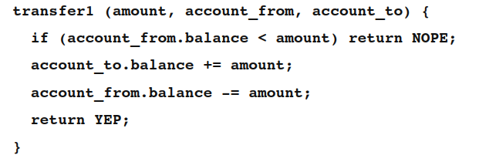
No Data Races
*with Safe Rust
Data Race != Race Condition
Data Race + Race Condition

Slide 7
Data Race and Race Condition

Slide 8
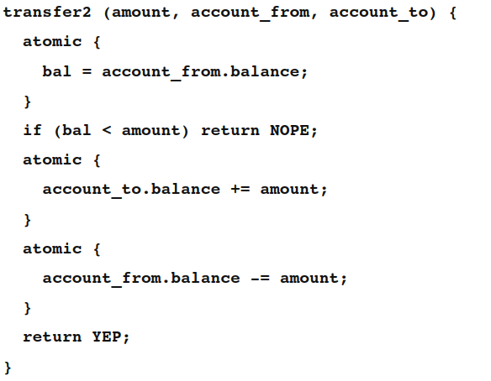
NO Data Race; Race Condition

Slide 9
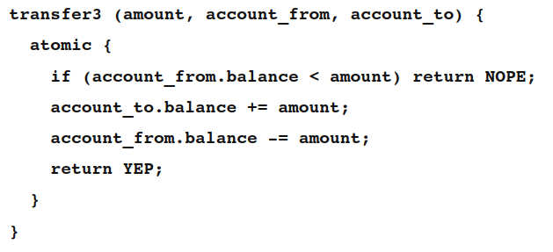
NO Data Race; NO Race Condition

Slide 10
Compilation Differences

Slide 11
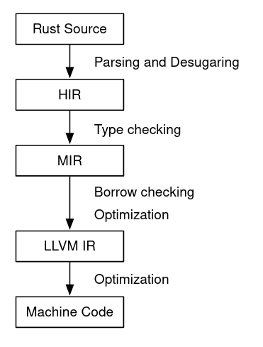
Compilation
Java → bytecode
JRE loads classes and interprets bytecode

Slide 12
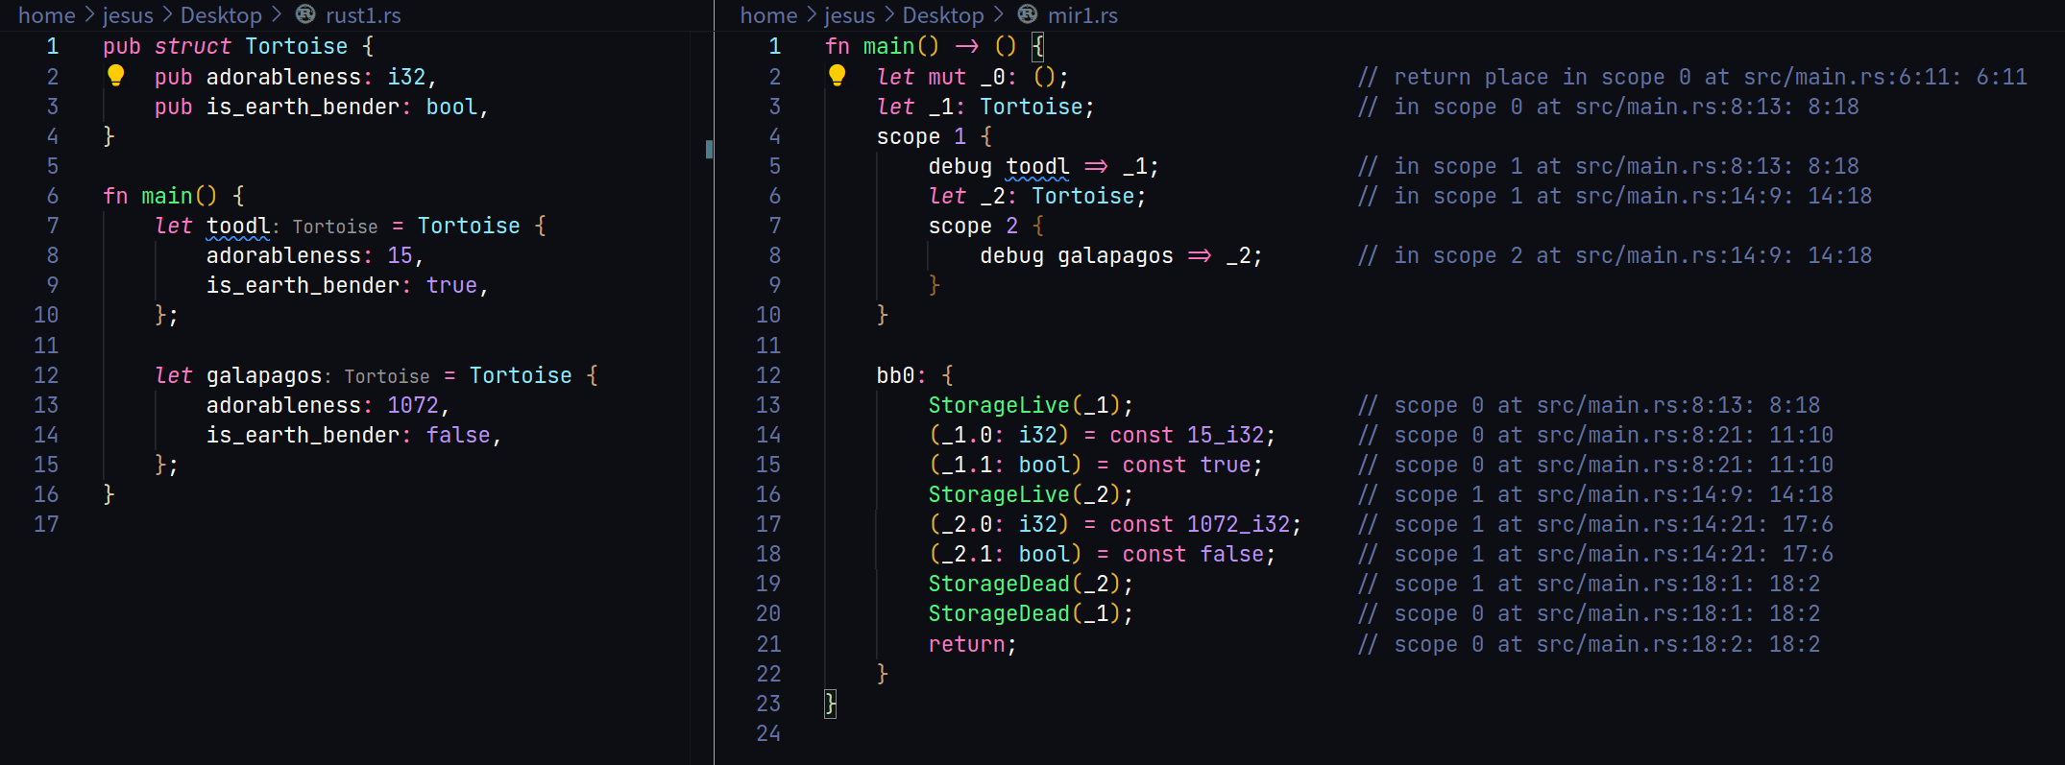

Slide 13
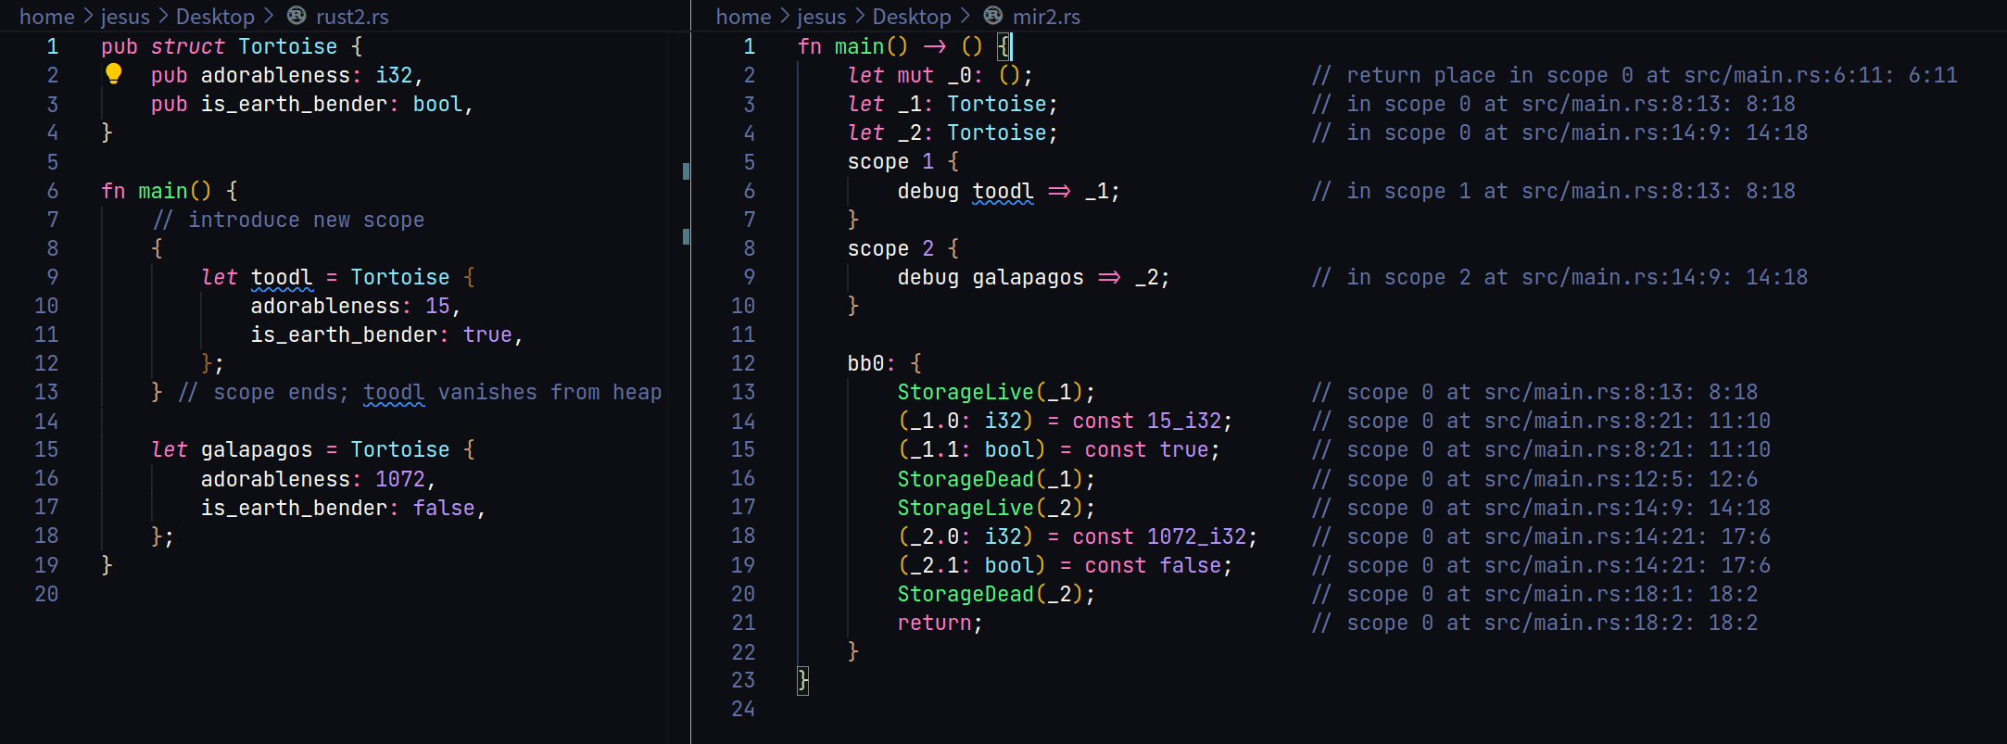

Slide 14
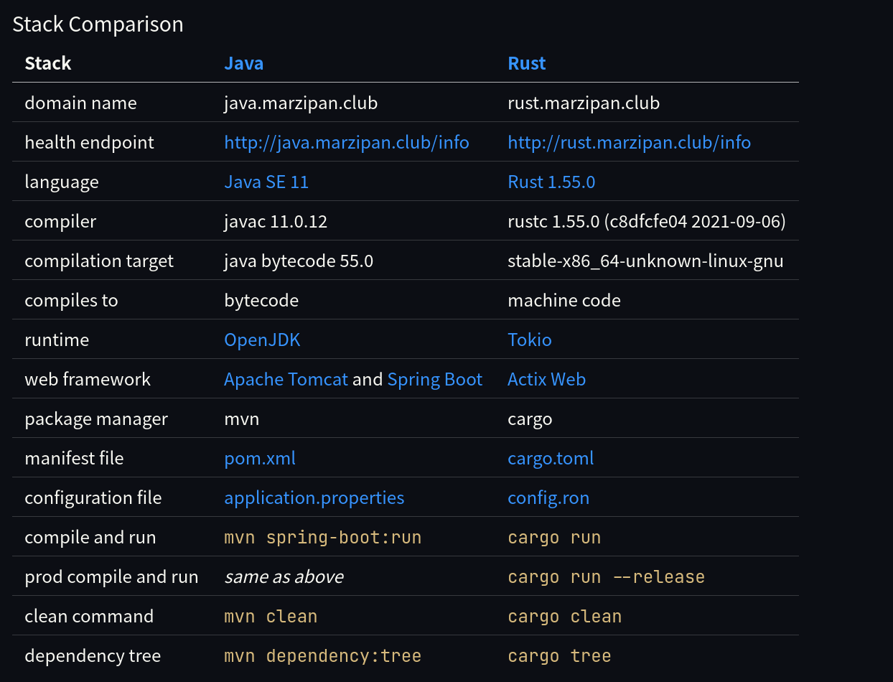
Source

Slide 15
How many requests can it handle?
Deserialize HTTP request to internal type
Validate fields
Process fields (e.g. hash password)
Send to Postgres
Serialize to json

Slide 16


Load Testing
cargo run --release --
--host http://{java,rust}.marzipan.club
-t10m (10 minutes)
-u80 (80 users/threads)
-r20 (spawn 20 users per second)

Slide 17
Results
Spring Boot 5,631
Actix Web 25,324

Slide 18
Recommended Talks
Considering Rust by Jon Gjengset
  https://www.youtube.com/watch?v=DnT-LUQgc7s
  More technical
Summer of Rust by Bryan Cantrill
  https://www.youtube.com/watch?v=LjFM8vw3pbU
  About the “feel” of using various languages

Slide 19
Demo Code
https://github.com/MarzipanClub/JavaRust

